Slide 2

The Most Important Things This Life Has To Offer!
YOU
The ONE THING?

Slide 3


ALL of the Spiritual Blessings God has to offer in this life & the life to come!
One Thing That Stands Between
MANKIND
The ONE THING?

Slide 4
Believing Jesus is The Christ, The Son of God
BELIEF comes from HEARING THE WORD OF GOD – Romans 10:17 NKJV 17 So then faith comes by hearing, and hearing by the word of God.”.
Jesus says it is ESSENTIAL for us to Believe on Him – John 8:24 NKJV 24 "Therefore I said to you that you will die in your sins; for if you do not believe that I am He, you will die in your sins."

Slide 5
REPENTANCE
All men COMMANDED to REPENT - Acts 17:30 NKJV 30 "Truly, these times of ignorance God overlooked, but now commands all men everywhere to repent,”
BUT – this is where most religious people will STOP!

Slide 6
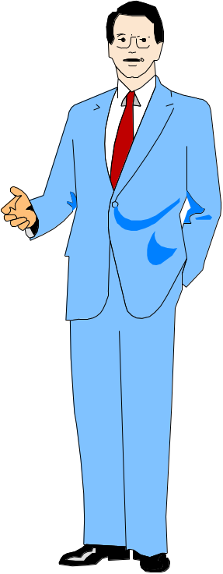
ALL of the Spiritual Blessings God has to offer in this life & the life to come!
One Thing That Stands Between
ALIEN SINNER
WATER BAPTISM

Slide 7
ALL of the Spiritual Blessings God has to offer in this life & the life to come!
One Thing That Stands Between
ALIEN SINNER
WATER BAPTISM

Slide 8
MARK 16:15,16
“And He said to them, "Go into all the world and preach the gospel to every creature. 16 "He who believes and is baptized will be saved; but he who does not believe will be condemned.”

Slide 9
BAPTISM STANDS BETWEEN THE ALIEN SINNER AND SALVATION
Acts 2:38 Peter was inspired by the Holy Spirit
He said BAPTISM was FOR THE REMISSION OF SINS!

Slide 10
Stands Between
BAPTISM
Alien Sinner
Remission
Of
Sins
WATER BAPTISM
Acts
10:47,48

Slide 11
Stands Between
BAPTISM
Alien Sinner
Washing away of sins
WATER BAPTISM
Acts 22:16 “Arise and be baptized, and wash away your sins, calling on the name of the Lord.’”

Slide 12
Stands Between
BAPTISM
Alien Sinner
Death of Christ
John 19:34 “one of the soldiers pierced His side with a spear, and immediately blood and water came out."
Matthew 26:28
WATER BAPTISM

Slide 13
Stands Between
BAPTISM
Being A New Creature
Alien Sinner
WATER BAPTISM
Roman 6:4,5 “should walk in newness of life”
2 Corinthians 5:17 “new creation”

Slide 14
Stands Between
BAPTISM
Putting On Christ
Alien Sinner
Galatians 3:26,27 “as many of you as were baptized into Christ have put on Christ."
Those NOT BAPTIZED IN WATER FOR THE REMISSION OF SINS are NOT CLOTHED WITH CHRIST!
WATER BAPTISM

Slide 15
Stands Between
BAPTISM
Sanctification
Alien Sinner
Ephesians 5:25-27 “sanctify and cleanse it with the washing of water by the word”
Cleansing is another blessing mentioned in this passage
WATER BAPTISM

Slide 16
Stands Between
BAPTISM
Put Off The Body of Sin
Alien Sinner
Colossians 2:11,12 “by putting off the body of the sins of the flesh”…buried with Him in baptism, in which you also were raised with {Him} through faith”
WATER BAPTISM

Slide 17
Stands Between
BAPTISM
Forgiveness
Alien Sinner
Colossians 2:13 “having forgiven you all trespasses."
NO forgiveness EVER promised to ANYONE since PENTECOST who has NOT been BAPTIZED for the REMISSION of their SINS!
WATER BAPTISM

Slide 18
Stands Between
BAPTISM
The Kingdom
Alien Sinner
John 1:1 “unless one is born of water and the Spirit, he cannot enter the kingdom of God."
Without water baptism, NO ONE will ENTER THE KINGDOM OF GOD!
WATER BAPTISM

Slide 19
Stands Between
BAPTISM
Good Conscience
Alien Sinner
1 Peter 3:21 “an antitype which now saves us, {namely} baptism (not the removal of the filth of the flesh, but the answer of a good conscience toward God)”
WATER BAPTISM

Slide 20
Stands Between
BAPTISM
Body Of Christ
Alien Sinner
Ephesians 1:22,23 “gave Him to be head over all things to the church, which is His body”
1 Corinthians 12:13 “For by one Spirit we were all baptized into one body—”
Ephesians 4:4 “one body”
WATER BAPTISM

Slide 21
Stands Between
BAPTISM
Wearing The Name Of Christ
Alien Sinner
1 Corinthians 1:11-17
The Only Way one can truly say they are “OF CHRIST” or a “CHRISTIAN” is if Christ was CRUCIFIED for them, and they were BAPTIZED IN THE NAME OF CHRIST!
WATER BAPTISM

Slide 22
The Most Important Things This Life Has To Offer!
Would stop at ANYTHING to get that ONE THING out of our way?
YOU
The ONE THING?

Slide 23

How much longer will you risk your ETERNAL DESTINY by refusing to get this ONE THING out of the way?
YOU
The ONE THING

